Slide 1



2020 World Happiness
Rankings
An Investigation
By
Robert Harris

Slide 2
What is Happiness?
Career Satisfaction
Social Fulfillment
Freedom and Liberty

Slide 3
Happiness is Subjective
Happiness is personal.
Where do the happiest people live?
What countries are the happiest?
Why are those countries happier?

Slide 4
World Happiness Report:
Average happiness of a country’s citizens
Gallup World Poll 2020 (N= 153)
Scoring - Cantril life ladder (0..10)
0 Worst possible life
10 Best possible life

Slide 5

Score - Major Factors:
GDP
Life Expectancy
Generosity
Social Support
Freedom & Liberty
Corruption

Slide 6

What Category to Investigate?

Slide 7

The Winner is:
GDP
Life Expectancy
Generosity
Social Support
Freedom & Liberty
Corruption

Slide 8
‘Freedom to make life choices’
Essence of Happiness encapsulates the opportunity, liberty, and freedom to pursue your dreams.
Minimum score 0.3966
Maximum score 0.9750

Slide 9
The DataSet:
Countries are ranked by ladder score (0..10).
Statistically comparing
countries in the ranges:
39-76: Q3
<vs>
116-153: Q1
Compare Freedom scores
Q1 FinlandF
Q1
Q3
39 Chile
:
76 North Cyprus
Q2
(Q2)Median=77
an
Q1
116 Armenia
:
153 Aphganistan

Slide 10
The DataSet Breakdown:
Rank Country Ladder Score Freedom Score
1. Finland 7.8087 0.9492
38. Uzbekistan 6.2576 0.9750
39. Chile 6.2285 0.7449
76. North Cyprus 5.5355 0.7953
78. Hong Kong 5.5104 0.7798
115. Nigeria 4.7241 0.7596
116. Armenia 4.6768 0.7120
153. Afghanistan 2.5670 0.3966

Slide 11
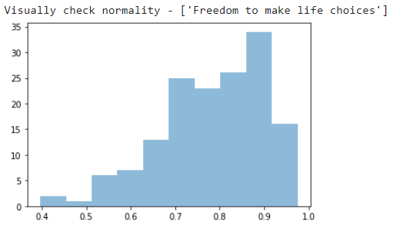
Statistical Considerations:
‘Freedom to make life choices’
was normally distributed
as visually evident
with supporting
quantitative data.

Slide 12
Therefore:
Conclusions were based on running an independent samples T-Test.
Quantitative outcomes indicate that the probability of observing both data sets having similar average ‘Freedom to make life choice’ scores to be less than 0.001%.

Slide 13
Conclusions:
Within a 95% confidence interval I conclude there is a significant difference between the ‘Freedom to make life choices’ the citizens living in the two groups of countries believe they have.

Slide 14
Further Conclusions:
I conclude within the same 95% confidence interval that significant difference between average ‘Freedom to make life choices’ disparity exists between all adjacent quartiles of data.

Slide 15
Further Discussions:
Consider comparing multiple categories.
Consider ranking category significance.
Are categories weighted differently?
Any significant attributes missing?
Are particular regions more or less happy and why?

Slide 16

Thank You

